Slide 1
Welcome to Canadian Forces Logistics Association
Major J.J.A. Hansen, CD
Deputy Commandant, CFLTC
2 Nov 19

Slide 2
What is our purpose?
We are the only logistics unit with far reaching influence across all three services.
Logisticians enable sustained warfighting, anywhere, anytime, against any force in every mission – 7 days a week 365 days a year.
No missions go out the door with without a trained logistician in support.
Nowhere.
Ever.
Without logistics militaries cease to function.
Notes:
Everyone needs a purpose.
Value Proposition: What do we do better than anyone else?
We are the only institution that provides trained logisticians to all elements in the CAF. Our graduates support every mission around the world in nine different trades, everyday, all year. We train logisticians and we do it better than anyone else. Our graduates are recognized as experts in their fields because of the training we provide. Logisticians lead sustainment.
CFLTC enables sustainment through training that is lean, flexible, current, and efficient
We are cultivating a professional, credible logistics force of sustainment warriors.

Slide 3
Strength
Officers = 34
NCMS = 163
Civilians = 10
Total permanent staff : 207 (filled (199)
Commissionaires = 3
Contractors (Calian) = 33 (filled 29)
Key Figures
111 different courses
300 serials / year - avg
4,000 students / year - avg
Courses duration: 5 to 140 trg days
Average pers at CFLTC / day – 753
(Lowest 506, Highest 975)
Cmdt
Chief Strategy
Adm Asst
RSM
CA COE
D/Cmdt
Adjt
RMO
OpsO
PlansO
OIC PAT
Ops
PAT Pl
OR
Fin
Procurement
HR/Fin Div
Tn Div
Sup/FS Div
Log Ldrsp Div
Music
X Div
Stds
HRA
FSA
Tpt
Tfc
Sup
FS
TIC
Postal
(Trenton)
Notes:
Quick refresher on our structure for those who may not be new to the Advisory Committee

Slide 4
Staff Strength & Figures
34 x Officers
163 x NCMS
10 x Civilians
207 Total
4 x Commissionaires
33 x Contractors
111 different courses
300 serials / year
4,000 students / year – avg (6,000 20/21)
Average pers at CFLTC / day – 500 to 1100

Slide 5
CFLTC Vision / Mission
Vision
CFLTC will pursue excellence by leveraging innovation, technologies and partnerships to professionalize training as the national logistics centre of excellence and logistics home station.
Mission
CFLTC will deliver high quality training in order to produced well-disciplined, technically sound operationally focused NCMs, officers and civilian defence partners who contribute to operational success.
Notes:
Our vision represents the long term strategy.
Train to be military professionals; and
Leader in all things logistics in DND
Our mission represents our daily operations but I just want to focus on high quality by doing things faster, cheaper and better. We train the current and future generation of logisticians to meet and exceed the standards required of their employment.
Highest quality means:
Relevant: We need to make sure our trg is fit for purpose, we shouldn’t be training people in procedures that our no longer used, simply because it appears in or training plan. We deliver training that is current and readily applicable.
Effective – business performance terms, we talk about the 3 Es Effective, efficient and economic. Which means doing what is required, with the least amount of resource, at the lowest cost. Our effectiveness is driven by the Qualification Standard related to the job, from which the training plan and master lesson plans are derived.
Modernized: we need to deliver training to meet our student learning needs. That is the only reason we exist - to support our students learning.
The old days of karaoke style lectures are over because they are too instructor centric and do not validate what the student hears or has absorbed. Our modernized approach applies a blended learning approach using a flipped classroom, where students read or complete online tasks related to technical content, validate their learning through group discussions or by completing job-related activities in the classroom to help cement their knowledge and by using job aids and quick reference guides that will support them in their future roles. Instructors become facilitators rather than lecturers.

Slide 6
CFLTC Lines of Operation
Training Delivery
Training Modernization
Routine Management
Morale, Welfare and Military Ethos
Notes:
Main Effort derives from Op Generation where we are trying to reduce the training time it takes to get offrs and NCMs qualified to OFP and out to the units.

Slide 7
Training Modernization (Offrs)
MLPWB LOCC (students)
LOC(L) DL and Field Ex (incorporating Reserve Units/Assets)
NLO(A) MLPWB - imminent.
DOPP (Deployed Operations Procurement Process) AKA OPC – on line solution.
Notes:
LOCC – we weren’t getting the support for CFPOT tasks for MLPWB and with the TP having been authorised in 2017, I took the unusual step of asking students to build the material after they had completed their legacy LOCC trg. Under the expert guidance of Capt Wookey, 120 students developed the training material with a modernized approach in mind. The results were some interesting and varied options for activity based training. We are now validating the content with SME’s from within CFLTC and placing the technical content onto an on-line platform, intime for LOCC serial to run in Jan 20.
LOC(L) will be predominantly DL (similar to AOC) and students will arrive for the Field Ex of testing. I have spoken with reserve units and we will attempt to dovetail their training needs with LOC(L) exercise phase. That means they will provide military vehicles and a more realistic OPFOR.
DOPP – contracting officers work in isolation, yet we continue to train using syndicate/group activities. This is unrealistic and I believe this course can be run using an on-line solution, supported by assignments and potentially marked by desk officers in CJOC. The demand is high and it is meant to be just-in-time trg for people deploying on operations however this has not been the case. In the past those that were qualified and subsequently deployed on Operations completed a confirmatory period trg provided by CJOC, immediately prior to deployment, which is not efficient and with todays scrutiny on TD funds, hardly justifiable.

Slide 8
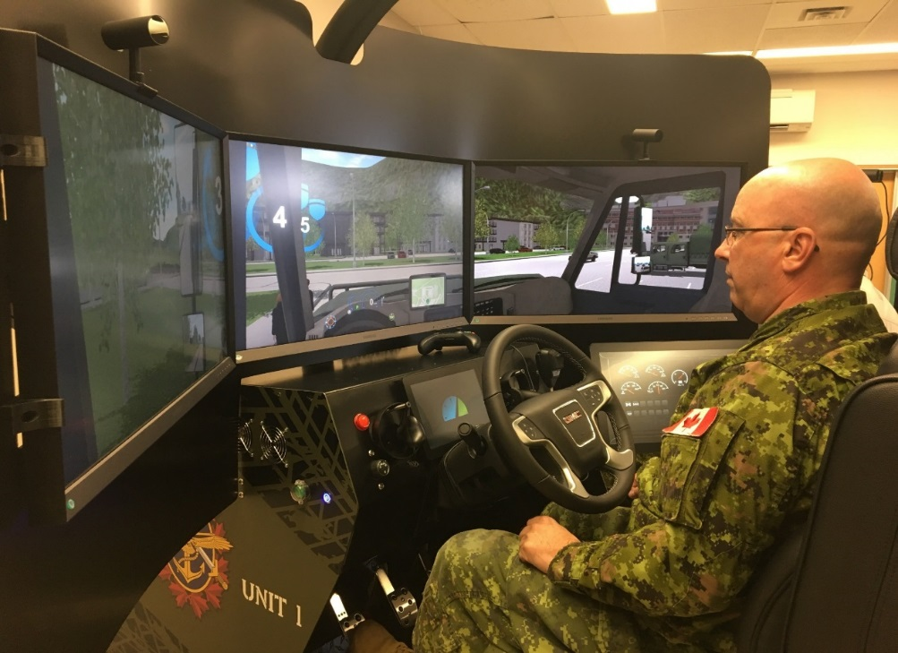
Training Modularization
MSE Op.
Core Module – 4 veh licences (pilot taking place now)
Speciality module (3 additional licences) - Jan 20
Notes:
Oct 2019 serial – “Core Module” – key changes:
Students progress through training at their own pace in a competency-based assessment model (achieve key skills vice number of hours)
round-robin style trg so students who pick it up quickly can move on to next vehicle (vice waiting for the rest of their course to catch up first) – this also allows room to bypass certain vehicles if students already hold qualifications from other trades (partial PLARs)
use of driver simulators to reduce down time & improve instructor-student ratios (2 to 1 vice 4 to 1)
Jan 2020 serial – starts with “Core Mod” as mentioned, upon completion students will progress to “Specialty Module”:
will introduce 3+ additional vehicles, including tractor-trailer and heavy equipment (exact pieces TBD depending what we can get our hands on – aiming for loader, refueller, and dump truck to start) Similar to core module; competency-based assessment, round robin style trg, driver sims

Slide 9
Training Modularization
Ammo Tech. Following modernization initiative, modularization is planned that will enable smaller courses to be run more often and maximise use of ranges – Jun 2020.
Notes:
Ammo Tech. Students will progress through training in smaller packets but on a more regular basis so that we can get them to the their unit more quickly. It will also provide greater flexibility and a more efficient use of ranges.

Slide 10
RCLSI Campaign Plan
Lines of Operation:
Governance
Occupation Management
Professionalization
Esprit De Corps
Strategic Communication
Notes:
This is the RCLSI campaign plan. As mentioned in the “purpose” slide, CFLTC has a far reaching Logistics influence across all three services. On average, we have 800 logisticians in the training centre on any given day and this number increases to over 1000 during peak training times. As such, I would just like to end by talking about the two areas where we can contribute to the RCLSI campaign plan. Professionalization and building esprit de corps.

Slide 11
Professionalization
Land Log Textbook
Log Journal
Supply Chain Canada
SCMP Qual MOU signing (28 Nov 19)
Notes:
Supply Chain Canada - Supply Chain Management Professional (SCMP)Qualification
Officers who have completed Supply Officer training will receive advance standing towards the academic program components of SCMP (4 modules and 3 interactive workshops).
Required to complete 4 modules and 3 interactive workshops, residential week and final written exam to be awarded the SCMP qualification.

Slide 12
Welcome “Home” to the centre of Excellence in Logistics

