Slide 1
Canadian Forces Logistics Association Ottawa Chapter 17 Feb 2015 SUPPLY Part II
LCol Darrel Zientek CWO Brad Curtis
Co-Advisor Asst Co-Advisor

Slide 2
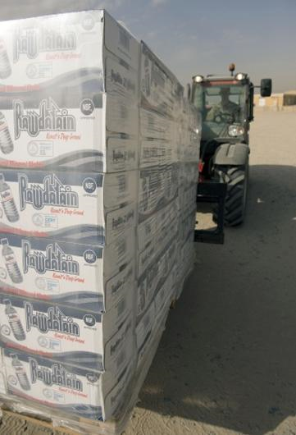
Supply Update Roadmap
The Supply Chain ( a small piece)
Officers
NCM
CertWork+
Coin
Situational Awarness

Slide 3
Supply relationships/ Geographic Map
( For illustration purposes only)
Calgary
Cold Lake
Moose Jaw
Winnipeg
Dundurn
Greenwood
Gander
Shearwater
FMF-CS
Wainwright
Base
Halifax
Edmonton
7CFSD
SHIPS
Suffield
HMCS
Charlottetown
HMCS
Montreal
Sydney
Shilo
3 CSU
HMCS
St. John’s
HMCS Ville
De Quebec
Goose Bay
5th CA Div Reg Force Units
HMCS
Preserver
HMCS
Halifax
3rd CA Div Reg Force Units
HMCS
Fredericton
HMCS
Toronto
Gagetown
ETC
Base
Esquimalt
25CFSD
Bagotville
Comox
2nd CA Div Reg Force Units
Chilliwack
Valcartier
Kingston
St. Jean
FMF-CB
Toronto
SHIPS
Montreal
HMCS
Regina
HMCS
Vancouver
London
Petawawa
Northern Ont
Ottawa
Borden
Trenton
North Bay
HMCS
Winnipeg
HMCS
Calgary
Legend
4th CA Div Reg Force Units
Meaford
Alert
ARMY
Air Force
HMCS
Protecteur
HMCS
Ottawa
NAVY
CJOC/CMSG
ETC
Notes:
It has been said repeatedly that a picture express 1000 words…I just want to show a pictorial of the inter connectivity of the CAF Supply Chain…and how the environments are supported. This does not incl other agencies, (PWGSC, Industry, the Transportation modes etc).
Overlay sp to Operations, DRMIS (Defence Resource Management Information System), IMMRP, (Inventory Material Management Rationalization Project) NSI (National Stocktaking Initiative) Defence Renewal (2.1 and 2.2)…and you ca see that the Supply professional with the CA, RCN, RCAF and the other L1 are working a complex and changing environment. An as a rexsuly must be adaptable, flexible and educated.
The skill set required to work at the unit level all the way up to the strat level requires continuous training and learning….That said CWO brad Curtis and I want to provide you with an update on were we are and where we want to go.

Slide 4
Supply Officers Update
Supply Officer Course
entry level Supply Officers (Base, wing etc…)
Not reviewed since 2008
Supply Chain Management Course
Provide a higher level of understanding ..improve efficiency
Not reviewed since 2008
Update Unit Log O QS
Completed and awaiting approval
More joint focus (CA + RCAF)
TPWB to be scheduled
Notes:
Currently there are the Supply focused courses for the Supply Officers…Except fpor the Unit Log Officer course (formally QM course) none of the QS have been update since 2008 but te way we do business has changed.
We have gone from the CFSS and the CFSM to the DGSC and the SAM
We have moved from MIMS to DRMIS
We have slipped I our focus on inventory accountability (hence the CDS/DM directive)
More focus on Controlled Goods…just to name a few

Slide 5
Supply Tech Update
Required Update due to DRMIS…
Updated Qualification Level (QL) 3
Qualification Standard (QS) Completed, approved
Teach Points (TP) now scheduled (2-20 Mar 15)
Update QSRB for QL 4, 5A and 6A
Proposed dates
QL4: 13-14 Apr 2015
QL 5A: 4-8 May 2015
QL 6A: 8-12 Jun 2015

Slide 6
Riggers
Rigger Challenges
Career Path
Recruiting
Training framework
Positions 50 x CAF
23 at CAAWC
27 across CAF (Skyhawks, SAR, CANSOF, LIB, DAEPM)
Notes:
Independent Occupation
Remain Sub Tech
OT only ???

Slide 7
CERTWORK +
CERT Work + Plus is a national project that is a Joint Venture of Canadian Manufacturers & Exporters (CME) and the Canadian Labour Congress (CLC). Based on the model of Prior Learning Assessment (PLA), the project is intended to demonstrate what an individual can do in the absence of an external qualification or designation. Therefore, the focus of the certification process will be on production workers and shop floor managers.
Notes:
Work-based Certification
Work -based certification is based on a set of applied skills that are identified as requirements to succeed in the job. Evidencing the required skills, through a rigorous recognition of prior learning assessment process, often completes work-based certification. It is equivalent to, but not the same as, certificates issued by post-secondary education.. Work based certification programs assume that candidates have the skills and knowledge; but may need some guidance to collate that knowledge for certification.
The value of the CertWORK+ Certification is that it is work-based and not academic. CertWORK+ assumes that candidates are not novices in their field of work while academia assumes that candidates are novices. This makes the CertWORK+ program unique.

Slide 8
CERT Work+ Goal
Assess, hire and promote based on certified skills, measured against industry-validated standards
Our Goal
Supply Technicians to take skills learned and practiced in the CAF over their career and gain a certification within Industry..
Notes:
CWO Curtis and MWO Pearson have been working with the program leaders in the area of “Storesmen” in essence to compare /standardize the work of CAF Supply Techs with the end state of enabling our.. The expectation is that the crossover from Military to Industry will be simplified and the skill set we bring will not only be well recognized, well regarded BUT Highly sought after employees.
This line of operations is supported by CDA..

Slide 9
Situational Awareness
Supply OA
Was due in 2015 now pushed to the right
Canadian Forces Supply System rebranded to Defence Global Supply Chain (DGSC)
Canadian Forces Supply Manual now Supply Administration Manual (SAM)…on line!
IMMRP Inventory Management Modernization and Rationalization Project
Notes:
IMMPR
The Inventory Management Modernization and Rationalization Project (IMMRP) was stood up in January 2014 to help rationalize dormant stock holdings and to identify and modernize critical inventory management processes. The IMMRP has a team of 17 Military PYs, a combination of Engineers and Supply personnel, and has a project duration of 5 years, ending in December 2018.
Rationalization activities are focused on the high value items from the dormant stock list and high volumetric items as identified by the four depot staff in order to maximize effect. High value is determined based on standard unit prices times quantity.
The NSC initiative will facilitate asset inventory clean-up across major bases and promote the accuracy and timely reporting of inventory and asset pooled item accounts leading to enhanced data integrity and increased compliance with Government of Canada policies and practices

Slide 10
Situational Awareness…
NSCI - National Stocktaking Capability Initiative
DM/CDS Directive Materiel Accountability
Validation of High risk items
Weapons systems
NVG
High value items (> $500K)
Historical price review
Materiel Accountability Action Plan
Notes:
The NSC initiative will facilitate asset inventory clean-up across major bases and promote the accuracy and timely reporting of inventory and asset pooled item accounts leading to enhanced data integrity and increased compliance with Government of Canada policies and practices

Slide 11
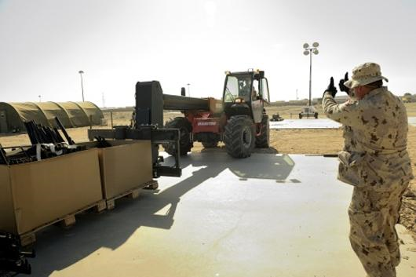
Coins
Notes:
Very well received
7 issued with the majority presented by Co–Advisor
Push to hand out to younger technicians
Presentations will be two fold…
Requested (to be accompanied by a short description)
In promptu presentations during visits (among peers)

